Slide 1

History and Accomplishments of the Consumer/Survivor/Ex-patient (c/s/x) Movement
Developed by the National Mental Health Consumers’ Self-Help Clearinghouse
http://www.mhselfhelp.org
800-553-4539

Slide 2
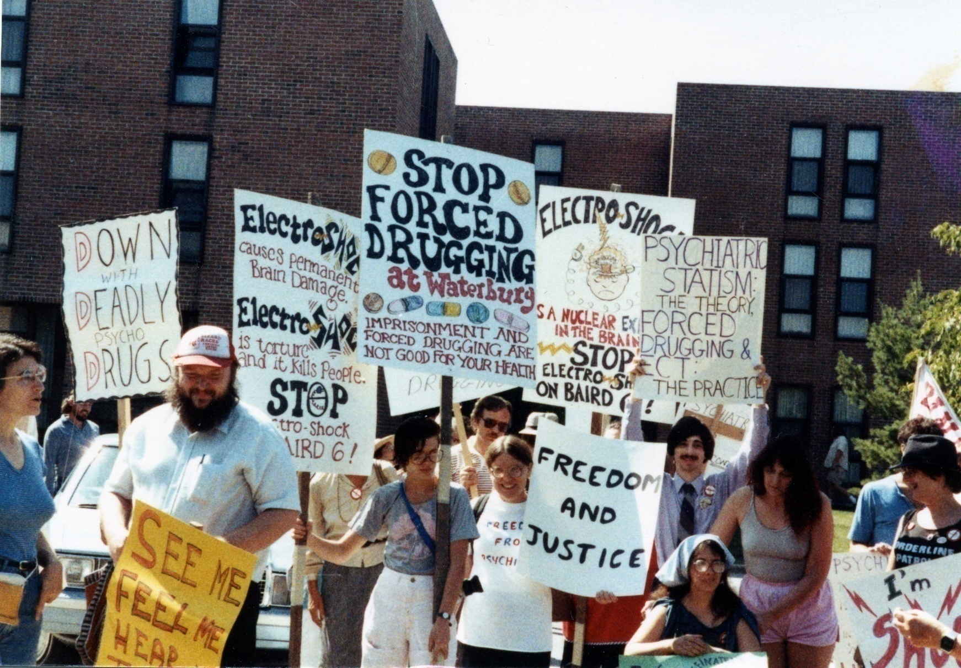
Peer Advocacy Movement Grew out of Struggle for Rights & Empowerment
International Conference on Human Rights and Against Psychiatric Oppression, Vermont, 1985
2

Slide 3
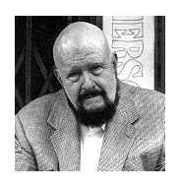
C/s/x Movement Roots Are in Civil Rights Movement and in General Self-Help Movement (AA, etc.)
“It is important to go beyond self-help and mutual support to systems advocacy.”
Frank Riessman
1924-2004

Slide 4
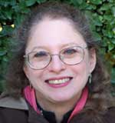
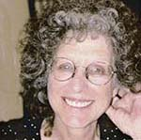
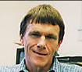
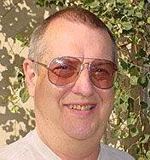
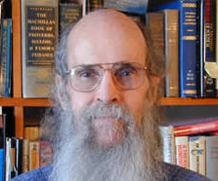
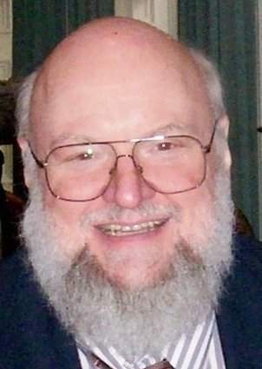
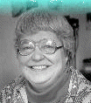

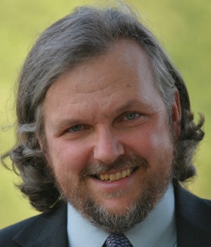
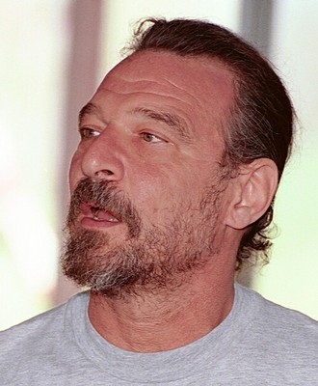
Ex-patients’ Rights Groups Form in 1970s and Early 1980s
…in Massachusetts, California, New York, Pennsylvania, Florida, Oregon
Judi Chamberlin
Sally Zinman
Jay Mahler
Ed Knight
Leonard Roy Frank
Sally Clay
Dan Fisher
David Oaks
George Ebert
Joseph Rogers
4

Slide 5
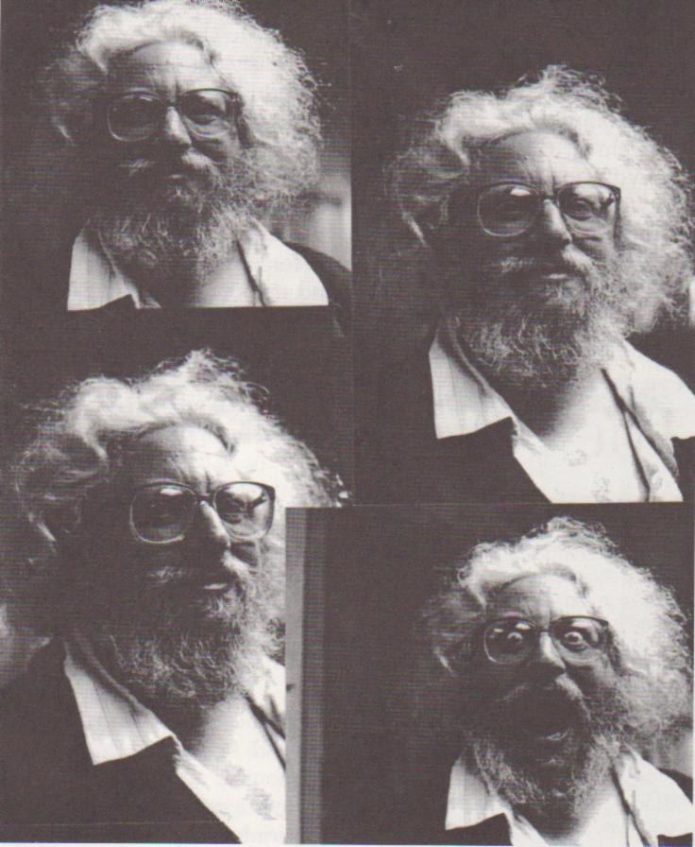
Movement Values
Control
Choice
Self-determination
Empowerment
Recovery
“We want as full as possible control over our own lives. Is that too much to ask?”
Howie the Harp
(1953-1995)

Slide 6
Conferences Unite Movement
The Alternatives conferences are organized by and for people with psychiatric histories. (Above: closing ceremony of Alternatives ’85, the first Alternatives conference, which 450 attended.)

Slide 7
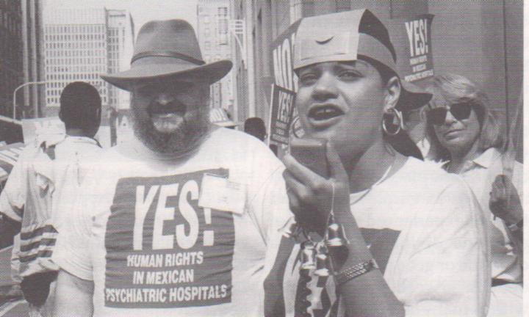
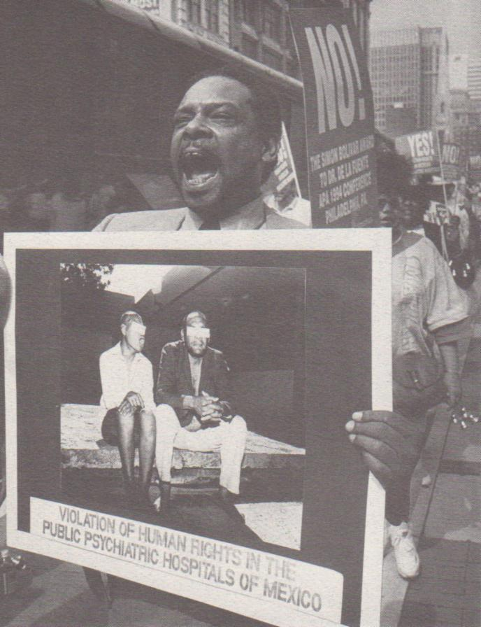
Frequent Demonstrations for Rights & Justice
Project SHARE demonstrates outside APA annual meeting in Philadelphia, May 25, 1994. Above, Joseph Rogers, Carmen Colon, Sarah Nathan. At right, Johnathan Evans.

Slide 8
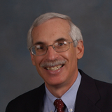
Movement Evolves, Gains Power
“A seat at the table”
Serving on boards and committees
Closing state hospitals
Legislative advocacy
Support on federal level
Neal Brown (right) and Jackie Parrish of the federal Community Support Programs Branch, now part of SAMHSA, helped the movement gain financial support.

Slide 9
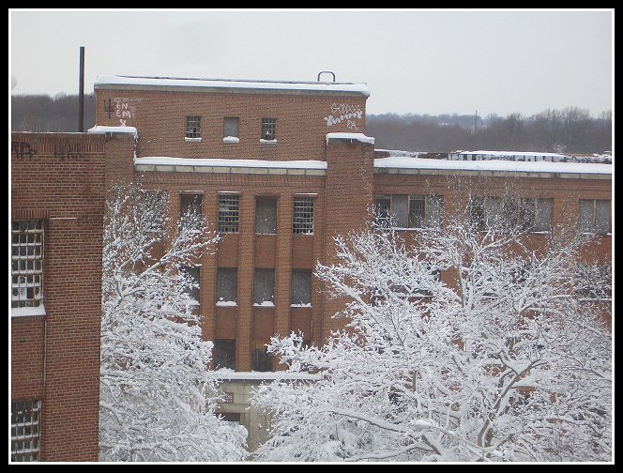

Accomplishments include helping close Philadelphia State Hospital and ensuring that the dollars followed the patients into the community (1990).

Slide 10
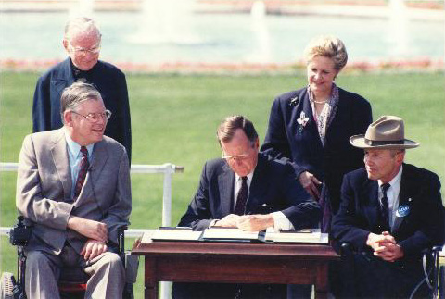
President George H.W. Bush signs ADA (1990), with Justin Dart at right.

Slide 11
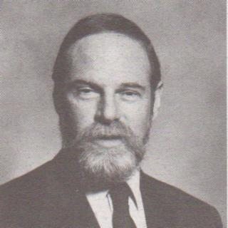
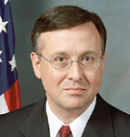
Decades Spent Convincing the Establishment of Peer Support’s Value
Presenting at conferences
Attending meetings of professionals and administrators
Serving on boards and committees
Writing and publishing articles
Former SAMHSA administrator supported recovery movement, fought S&R
1993 sit-in led to more funding for peer-run programs.
Dr. Bernard Arons
Charles G. Curie

Slide 12




5 National TACs Help Movement Grow:
www.mhselfhelp.org
www.power2u.org
www.consumerstar.org
www.cafetacenter.net
www.peerlink.us
12

Slide 13





Other National Groups Support C/S/X Movement
NARPA

Slide 14
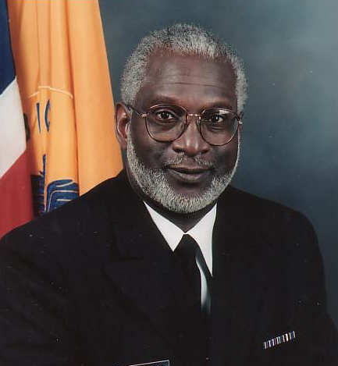
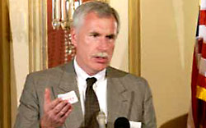
Paradigm shift: Establishment believes in recovery and accepts value of peer support
“Mental Health: A Report of the Surgeon General” (1999)
Report of the President’s
New Freedom Commission
on Mental Health (2003)
Michael F. Hogan, Chair, President’s New Freedom Commission
Then-U.S. Surgeon General David Satcher

Slide 15

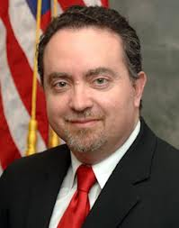
“Powers-that-be” realize that recovery-oriented, peer-run services are key to recovery
SAMHSA recognizes Peer Support as one of the 10 fundamental components of recovery. The 10 are:
Self-Direction
Individualized and Person-Centered
Empowerment
Holistic
Non-Linear
Strengths-Based
Peer Support
Respect
Responsibility
Hope
SAMHSA Administrator Pam Hyde (top); CMHS Director Paolo del Vecchio (bottom)

Slide 16

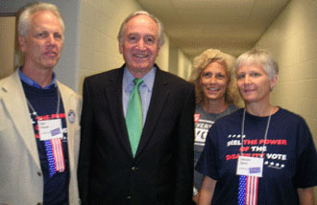
A national coalition of statewide consumer/survivor organizations, founded in 2006 to ensure that consumers/survivors have a major voice in the development and implementation of health care, mental health, and social policies at the state and national levels, empowering people to recover and lead a full life in the community.
Senator Tom Harkin, of Iowa, shares a special time with Dan Fisher, Rachel Freund, and Lauren Spiro at the Presidential Forum in Columbus Ohio, July 26, 2008.
16

