Slide 1



Reconnecting with the Earth for Personal and Global Healing
June 8, 2018
Rangi Ahipene, Maori Chief
Reverend “Luke A. Shootingstar” Walters
Jode Freyholtz-London, Wellness in the Woods
Moderated by Oryx Cohen, National Coalition
and Martha Barbone, International Association of Peer Supporters

Slide 2
Archive
This Webinar will be recorded. The PowerPoint presentation and the audio recording of the teleconference will be posted to the National Coalition website at:
http://www.ncmhr.org

Slide 3
Questions?
At the end of the webinar, there will be a Q & A session. You are invited to ask questions at any time through the “question” function. Questions will be taken in the order they are received. You are also welcome to make comments using the “chat” function.

Slide 4
Today’s Agenda:
Housekeeping, background, and speaker introductions – Oryx Cohen and Martha Barbone
Reverend “Luke A. Shootingstar” Walters
Jode Freyholtz-London
Chief Rangi Ahipene
Q & A

Slide 5


Slide 6
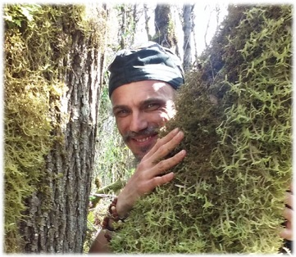
Rev. “Luke A. Shootingstar” Walters

Slide 7

Rediscovering Purpose
To Champion the Ripple Effect
            Presented by: Rev. Luke A. Shootingstar, PWS, PSS
            Founder of Ripples of Wellness Allied Networks (ROWAN)

Slide 8


The Journey of Rediscovery
“The Journey of a Thousand Miles starts with the first step…” It starts with initiative.
Can’t we just have someone
else do it for us?
Can it be pasteurized, cloned,
or grown in test tubes?
Can we put wellness in a
cookie or pill?
Or is it…an organic
phenomenon, with a life of its
own, individualized each and
every person?

Slide 9


The Journey of Rediscovery
What activities and ingredients promote our wellness or are counter supportive? What are the factors that caused our descent into despair, turmoil, dis-ease, suffering, and crisis? occurred in our life?
How did we ever fall away from grace
when we had our needs met for existence?
Homeostasis: a state of sustained balance

Slide 10
The Journey of Rediscovery
“What is crisis?” What does it look like, the absence of wellness?
If we see the tip of an iceberg, it can be an invitation to see more:
An example recipe of crisis:
Some of us find creating a road map,
like a recipe, to how crisis happened
for them or to find wellness helpful
to improve chances of success on
one’s Journey of Rediscovery.
Promotion denied
Lost job
Crashed car
Alcohol abuse
Divorced
House foreclosure

Slide 11
The Journey of Rediscovery
There are many models for maintaining health
and each has their rightful place and value.
Medicine and education are each very helpful
to till the soil for wellness to come again in life
So it may be sustained for a while in the metaphorical garden that is one’s existence.
Medical Model
Recovery Model
Wellness Model

Slide 12
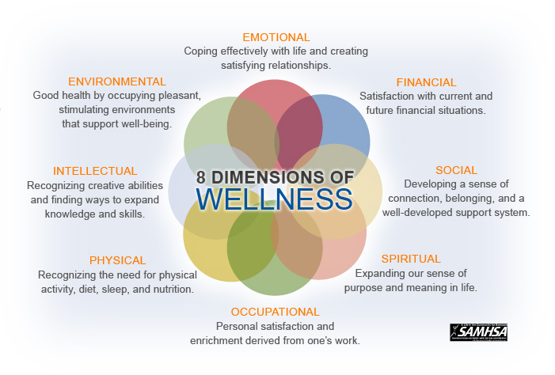
The 8 Dimensions of Wellness
Recognized as the center of the Wellness Model

Slide 13

To Champion the Ripple Effect
  The Journey of Rediscovery eventually leads to sustainable wellness support…
  which, when taken to a higher level is another way of saying “permaculture.”
…Just one drop is all it takes…
…to Initiate Ripples of Wellness…
On the Journey of Rediscovering Wellness, we raise awareness in our story,
history or herstory, of how our influential ripples led to wellness…or to woe…

Slide 14

To Champion the Ripple Effect
Each person’s sphere of influence is a different size,
depending upon their own capacity for attention.
For one it can be their neighborhood, province,
country, or quantum physics suggests for another
it may even be their whole planet or entire galaxy.
Be they large or small,
all our efforts do matter.

Slide 15
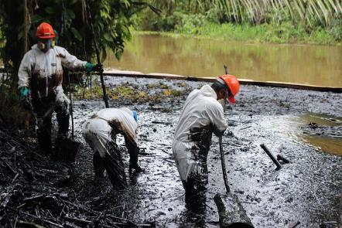
To Champion the Ripple Effect
To Champion the Ripple Effect is to achieve mastery
of sustainable wellness by cultivating great awareness
of the influence that spills over beyond one’s own life…
Mastering sustainable wellness is like finding a light or a supportive wind for the sails of a ship…a kind of “life force.” Therefore, to Champion the Ripple Effect is similar to the fictional role of a Jedi.The very real benefit, though, in taking up this mantle…is a rediscovery of purpose.
Expanding our sphere of influence
is possible as individuals or collectively,
in groups.

Slide 16
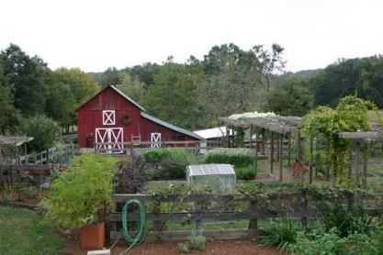
Regional Epicenters
  The Journey of Rediscovery eventually brings each
  person to a place in life where they want to be
  of service in a variety of ways, some examples
  of these include:
  Prevention—peer-run respite houses and vocational support programs
  Engagement—hospitality outreach teams and community events
  Support—day use centers and rural farming
  Collaborative Oversight—regional support epicenters, government advisory councils, and coalitions of allied organizations

Slide 17
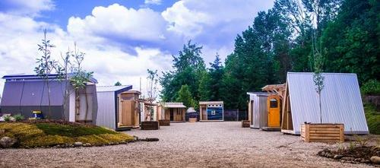
Regional Epicenters: Prevention
Influences we come into contact with in life can increase the risk that our homeostasis, balanced existence of wellness, is disrupted. A fall from grace can be avoided though, with enough supportive influences in your life.
Some examples of preventative services are:
New family/parent support programs
Peer-run respite houses
You can advocate to
increase funding of
preventative services
near you, too.

Slide 18
Regional Epicenters: Prevention
Supportive Content
Peer-run respite houses
New family parent support programs
Education and tabling at partner events
Public speaking at schools, colleges, charity events
Relationships with local law enforcement and government
Relationships with community based crisis response services

Slide 19

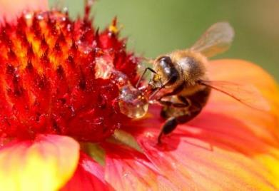
Regional Epicenters: Engagement
When we are back on the map of existence
again we associate, pursuing engagement
with life wherever we find it…And,
with rediscovered life purpose
comes renewed relevance, meaning that we belong.
Examples of Engagement activities can include:
Community service events
Hospitality services (food & beverage,
clothes, etc.)
Outreach to at-risk persons (refugees,
houseless, etc.)

Slide 20
Regional Epicenters: Engagement
Supportive Content
Engaging those who are
at risk, or beyond the point where prevention is as helpful is another option for influence in facilitated ripple effects.
Other engagement activities include:
Visits to managed care environments (some are locked up)
Tabling at partner events

Slide 21
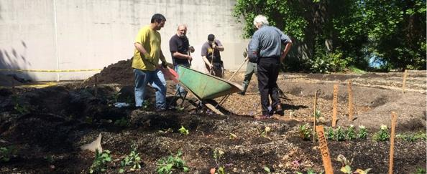
Regional Epicenters: Support
Wellness support can be for any areas that relate to the 8 Dimensions of Wellness. Activities at each location are weaved together intentionally through epicenters with strategic collaborations, to maximize mutual benefit of the local networks. This is how the Wellness Model is put into regional supportive action.
Examples of Support services include:
  Day-use drop in centers
  Job referrals, and in-house job
  programs
  Residential Supports (rural
  farming and long-term urban housing)

Slide 22
Regional Epicenters: Support
Supportive Content
Wellspring Labs (or clubs)
Residential Supports (rural farming and long-term urban housing)
Vocational training, job referrals, and in-house vocational programs
Crafting Halls for supporting creative development
Day-use drop in centers

Slide 23

Regional Epicenters: Collaborative Oversight
Coordination orchestrated through an epicenter to connect the points on the map of a region are weaved together intentionally for collaboration with locally allied partners. Some key aspects of this influence are:
Regional conference organization
Media productions to raise awareness
Joining government advisory councils
Quality standards, policy, and licensing
Forming and coalitions and associations (usually involves a charter)

Slide 24
Regional Epicenters: Collaborative Oversight
Supportive Content
  Recovery Learning Communities (RLC’s) are the only known peer-run structures that are similar to Ripples of Wellness Allied Networks. Although the resemblance is seen in the projects and activities coordinated through a central hub, as mentioned before the recovery and wellness models are slightly different in array service provision.

Slide 25
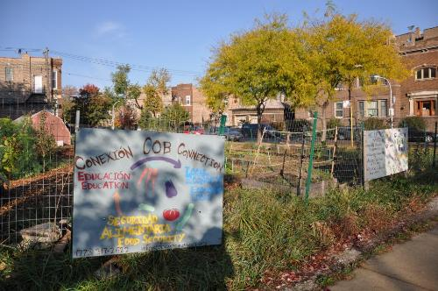
Merging Wellness Support With Permaculture
  Dedication to a cause and ability to make a difference in the community(s) comes from our becoming more aware of one or more of these dimensions in our own life.
  When wellness support is provided with
  an understanding of permaculture then
  the resulting recipe creates huge ripples.
  Examples of such activity combinations include:
  Respite houses built with reclaimed wood
  Crafting new clothes from unwanted clothes

Slide 26

Merging Wellness Support With Permaculture
  Some examples of organizations exploring the link include:
  The City Repair Project
  Earth Guardians
  Food By Design
  The reward of value that comes from the Journey of Rediscovery is insight into the nature of crisis and wellness. The inherent potential in bringing forth the value of successful recovery on the grandest of scales…
to revitalize our culture and every dimension of our world, is tremendous. This may be the next leap in our collective Journey, even as an entire species.

Slide 27

    May you find a way to deliver that reward....
..: Peering Beyond :..

Slide 28
I have a dream…
..: Peering Beyond :..

Slide 29
I have a dream…
That those of us who have suffered through the worst that life has to offer and lived to tell the tale will find strength within and self-respect for that we have overcome the most impassible of paths. We, she, he, and they have survived through a journey of darkest night and deepest underworld, can be heroes in the here and now, at this time of the greatest need, to share a light of hope and healing from this state of crisis on the grandest of planetary scales.

Slide 30
I have a dream…
May you find this place of respect in the world. The fires of life have forged wisdom and resiliency in you; we have been tested by the greatest of forces, and are found worthy; you are wanted. Let the value in you recovered from the Journey guide others to a way of grace. May our community of all peoples accept us for our place as the experts we are, to lead in the healing of our greater body that we exist within…may our Journey serve to revitalize and restore balance to our ecosystem…That we will know peace on Earth.

Slide 31
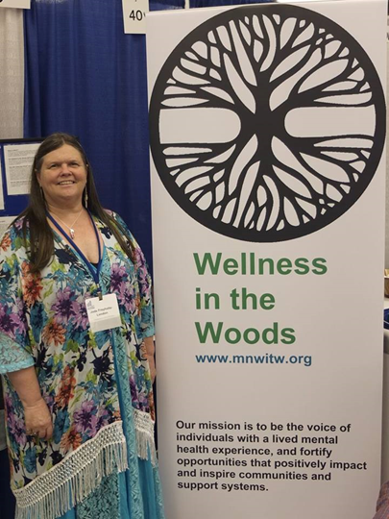
Jode Freyholtz-London

Slide 32
Wellness in the Woods
THE CENTER OF MY RECOVERY

Slide 33
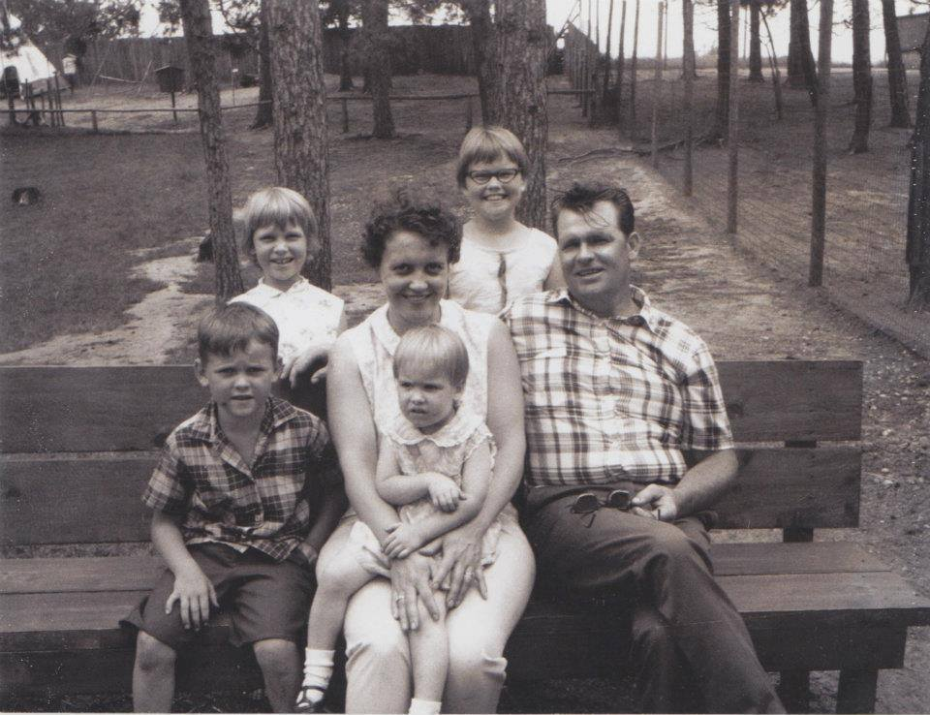
EARLY YEARS

Slide 34
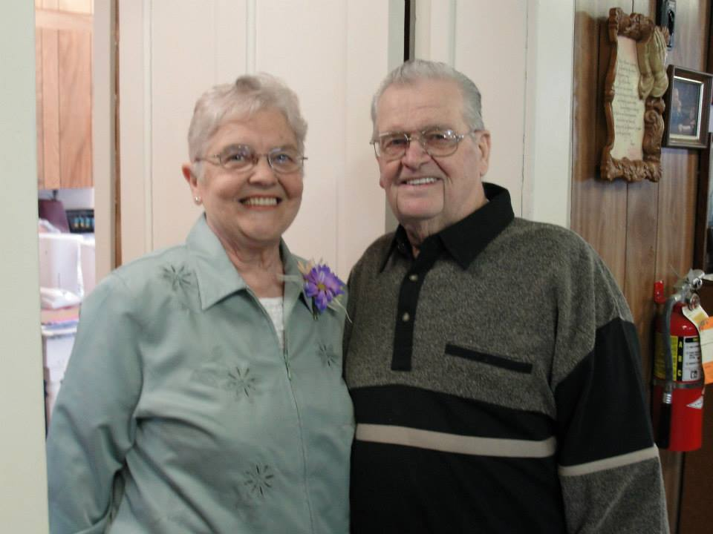
GROWING UP ON THE FARM

Slide 35
ORGANIC FARMING IN 1975
APPRECIATION FOR THE LAND
CARING FOR THE SOIL AND ANIMALS IN RETURN FOR THEIR GIVING
NOT USING POISON TO INCREASE PROFIT
HONEST RELATIONSHIPS
WORKING WITH NEIGHBORS
COLLABORATION WITH OTHER ADVOCATES FOR BETTER PRICES
FIRST OPPORTUNITY TO BECOME A PROTESTER

Slide 36
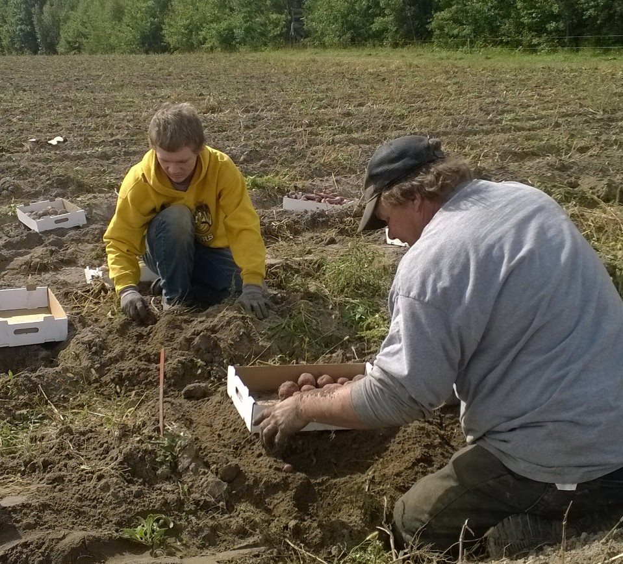
GARDENS AND RIGHTEOUS DIRT

Slide 37
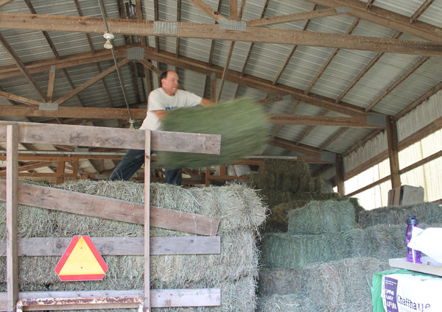
HARD WORK

Slide 38
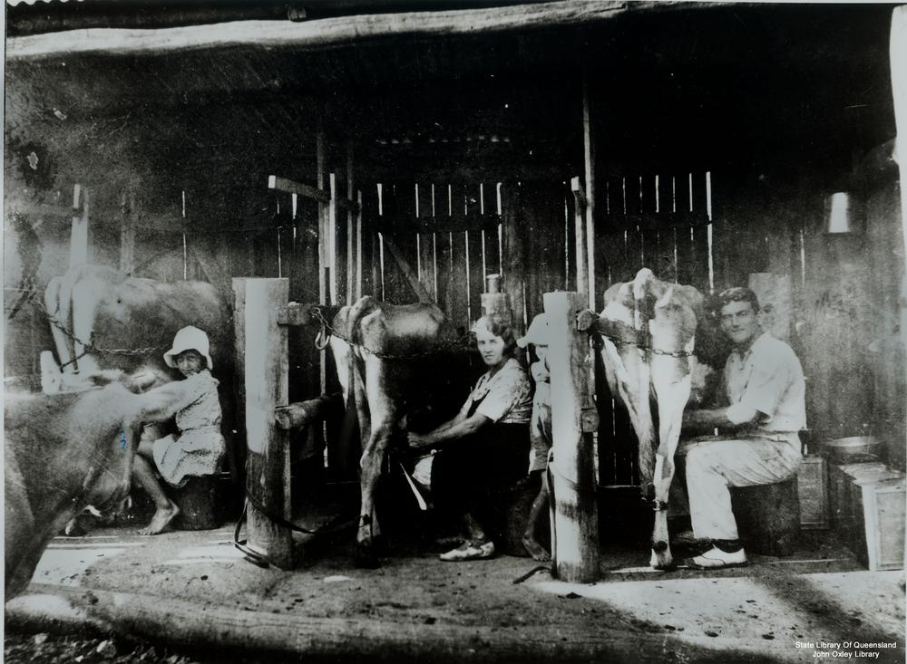
AND MORE

Slide 39
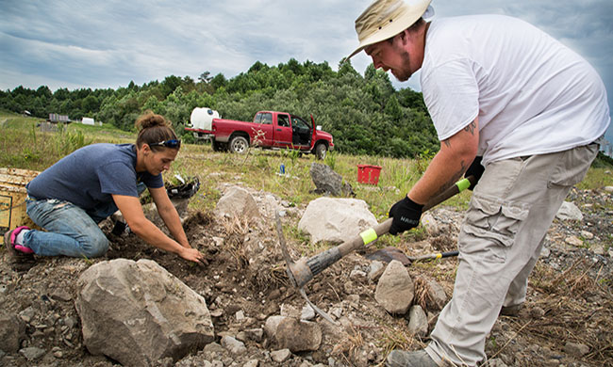
AND MORE

Slide 40
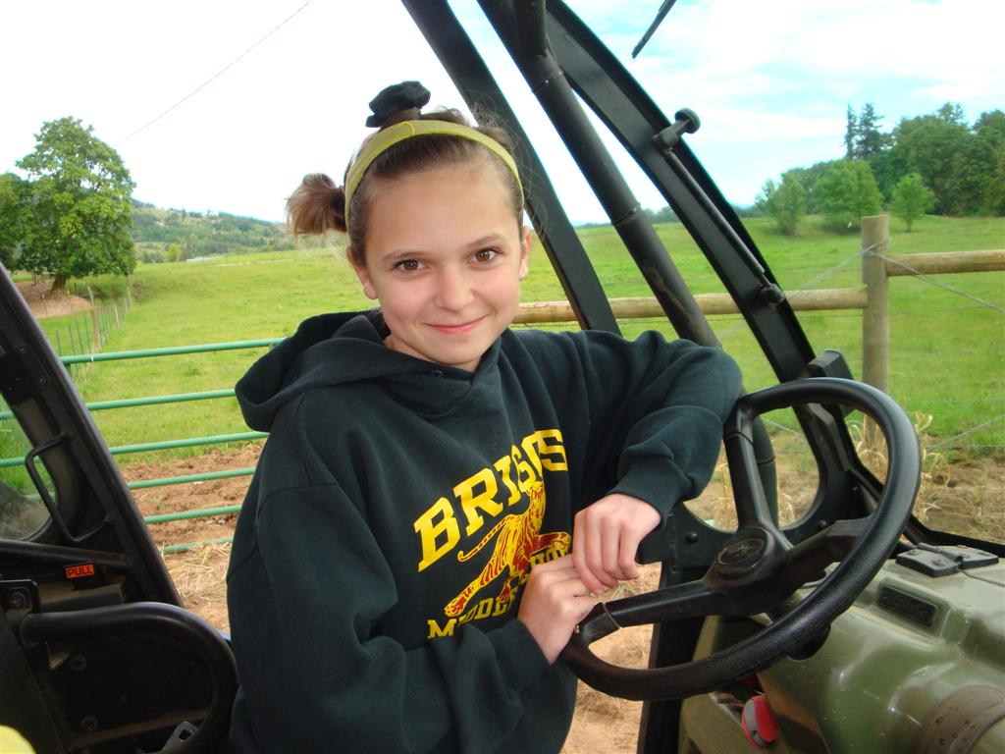
TEACHING SELF ADVOCACY AND RESPONSIBLITY

Slide 41
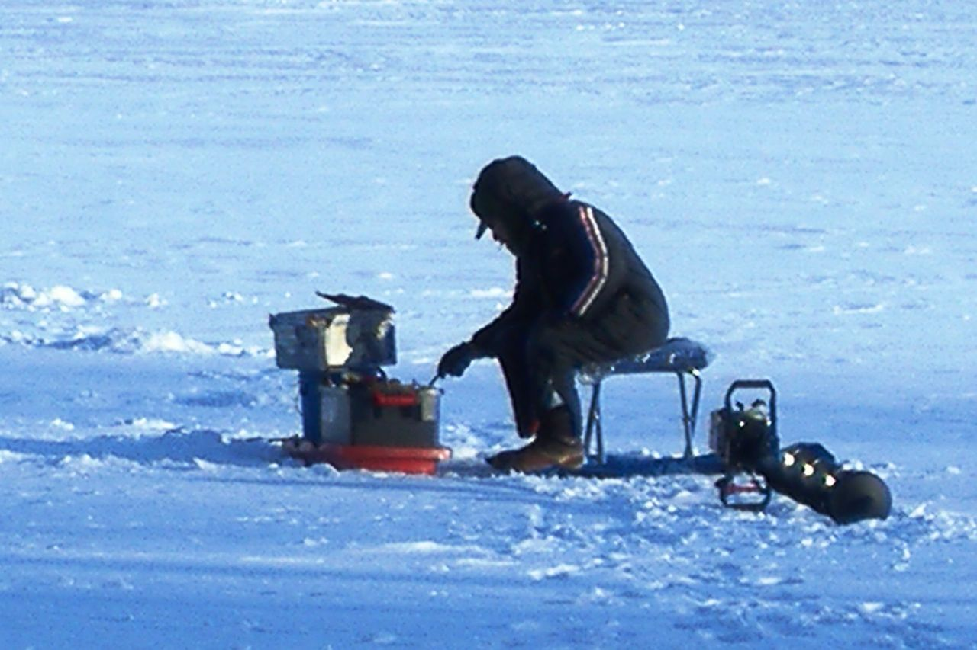
HARD PLAY

Slide 42
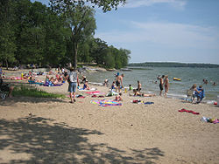
NATURE

Slide 43
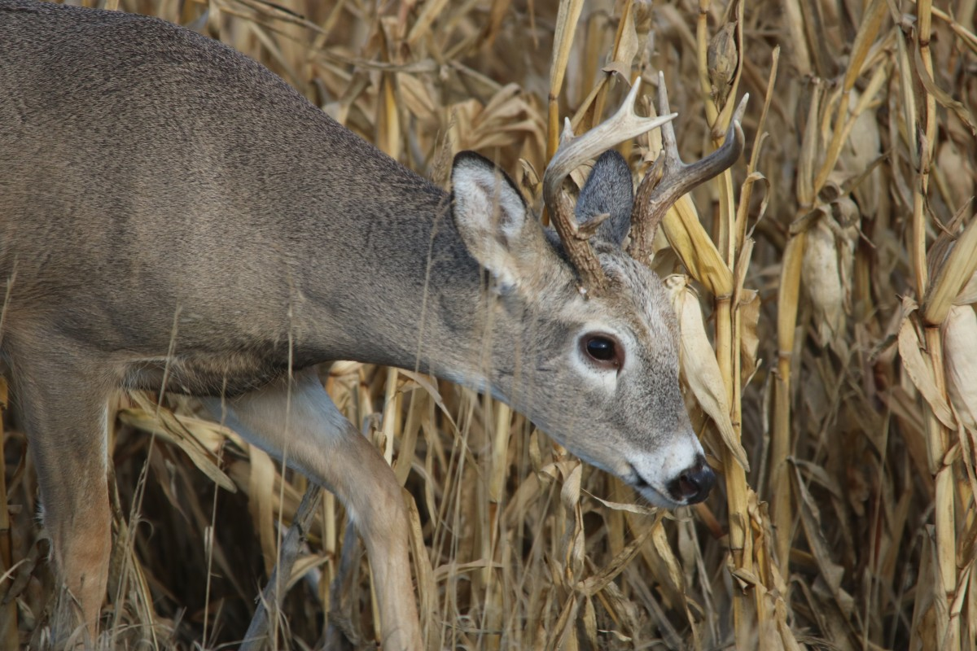
HUNTING

Slide 44
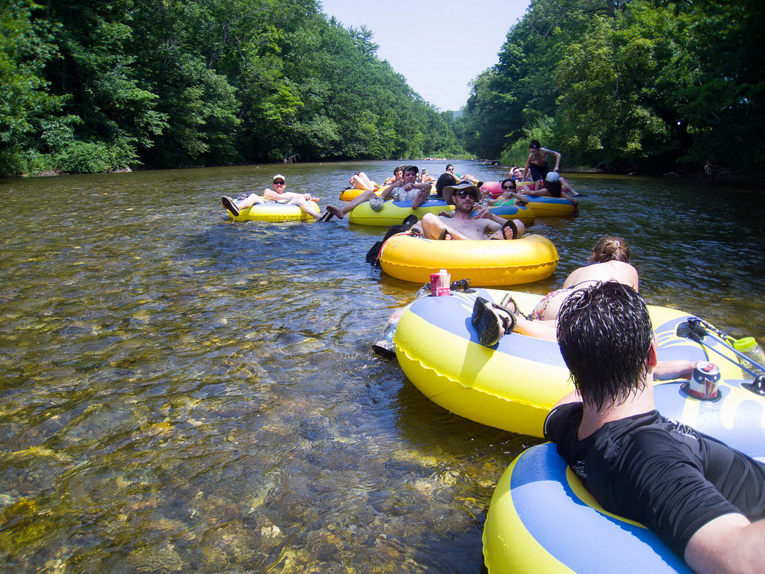
WATER AND PEOPLE TOGETHER

Slide 45
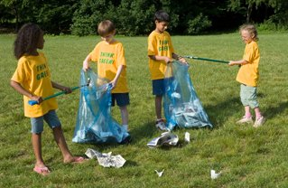
WE ARE RESPONSIBLE FOR OUR SURROUNDINGS

Slide 46
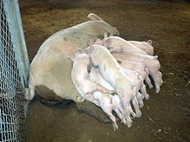
ADULTHOOD

Slide 47
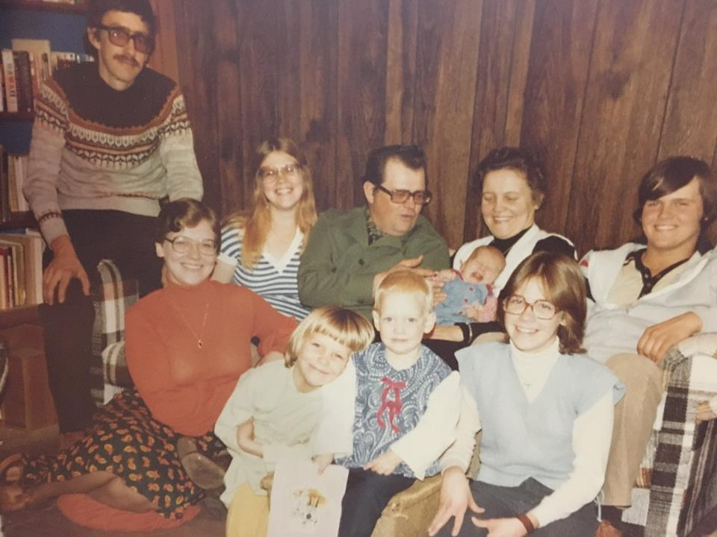
FAMILY

Slide 48
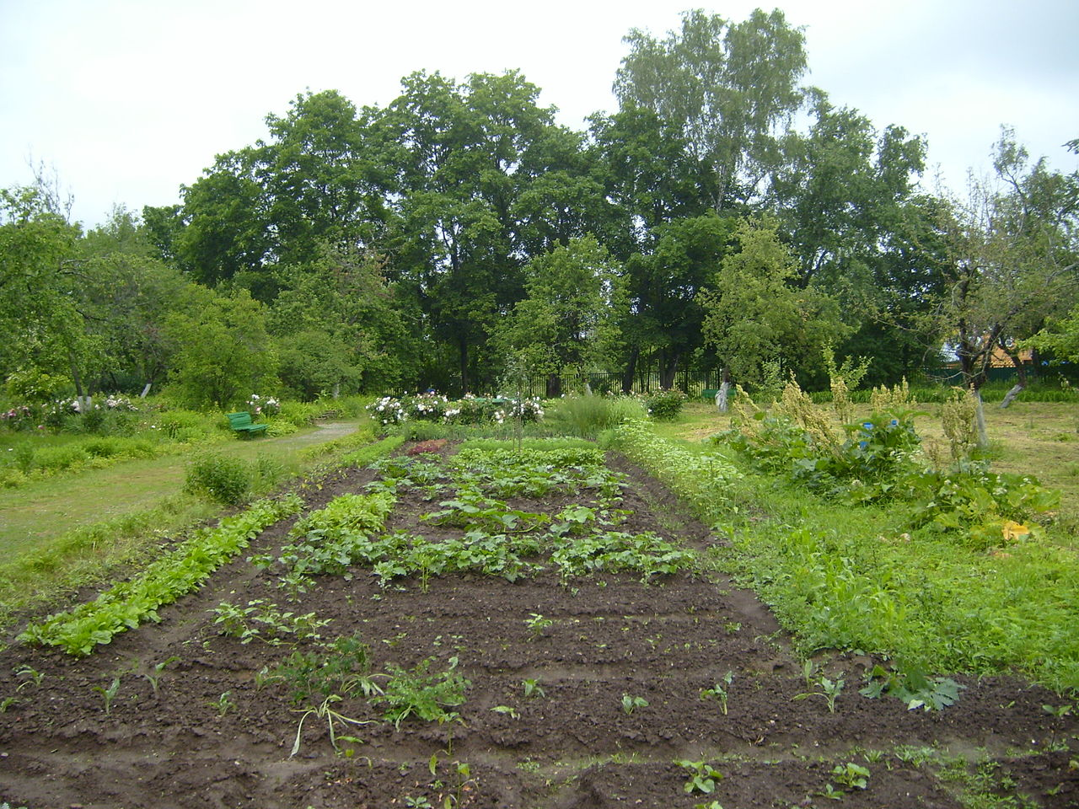
GARDENS AND SOIL
HANDS IN THE DIRT

Slide 49
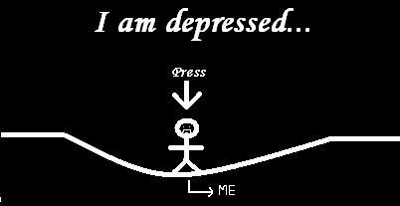
2005- THE BIG CHANGE

Slide 50
ENVIROMENTAL STRESSES
DIVORCE
SPIRITUAL VOID AND BETRAYAL
JOB LOSS
PSYCHOLOGICAL ABUSE
ANXIETY
FEAR

Slide 51
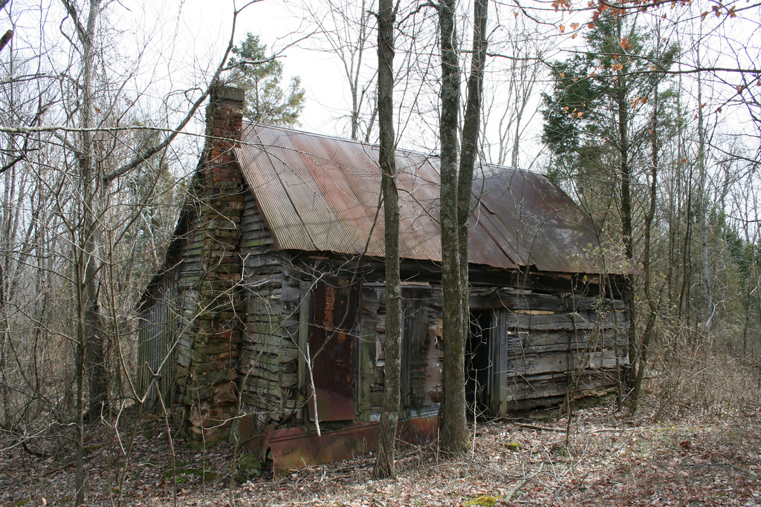
ESCAPE TO NATURE

Slide 52
NATURE PROVIDED
Solitude
A space to think
The wind in the trees
No people, no judgement
A place to cry
A place to pray
A place to heal

Slide 53
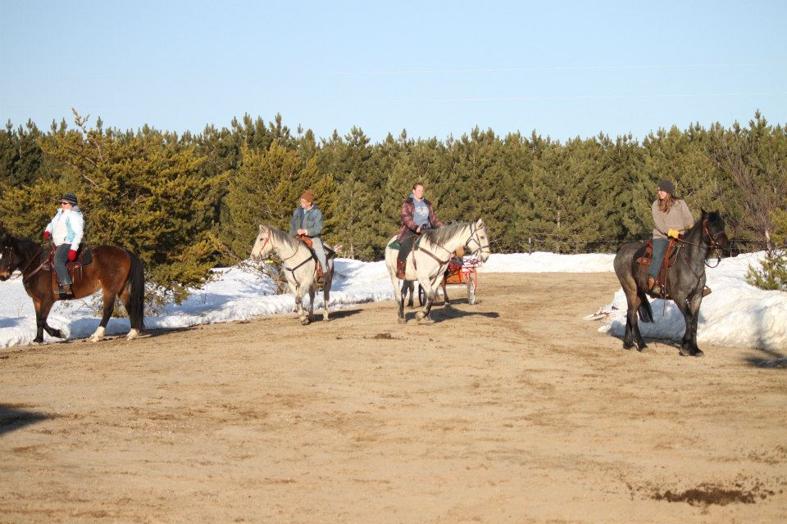
Nimrod MN- 40 acres- Sandy Creek Ranch

Slide 54
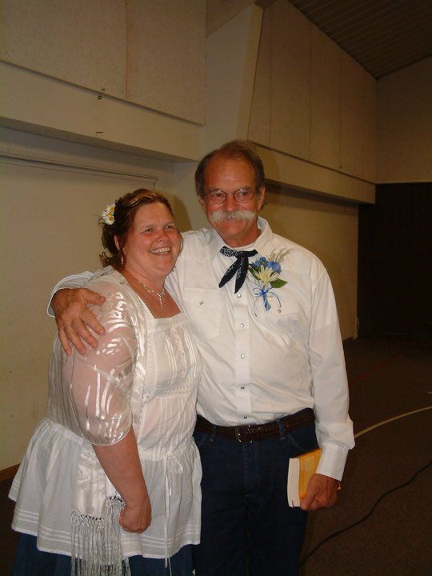
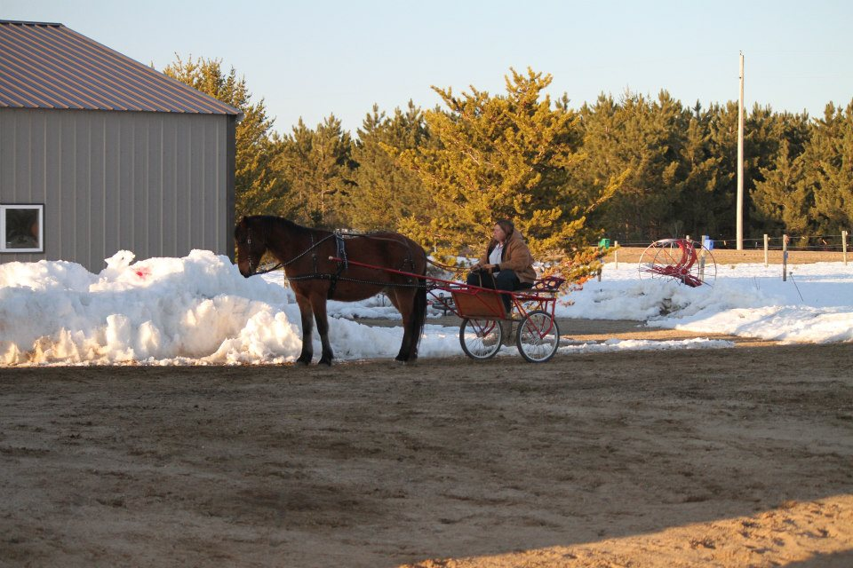
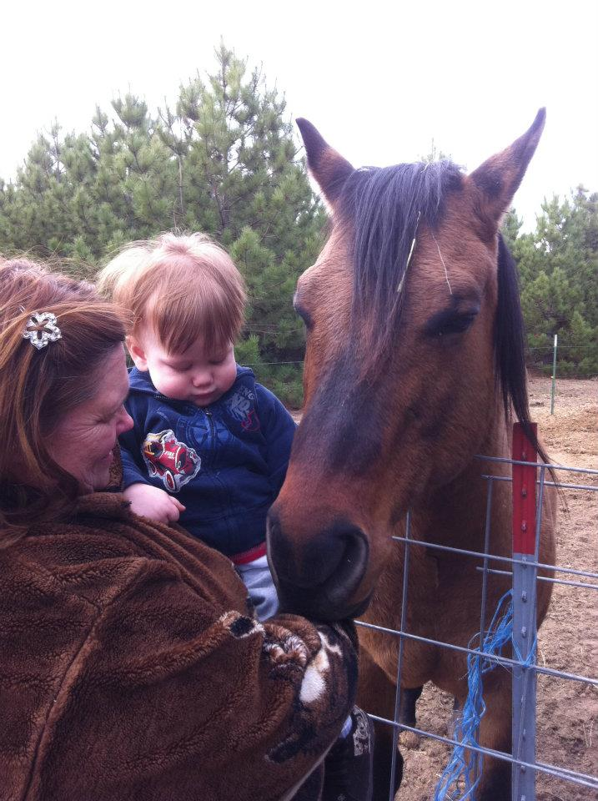
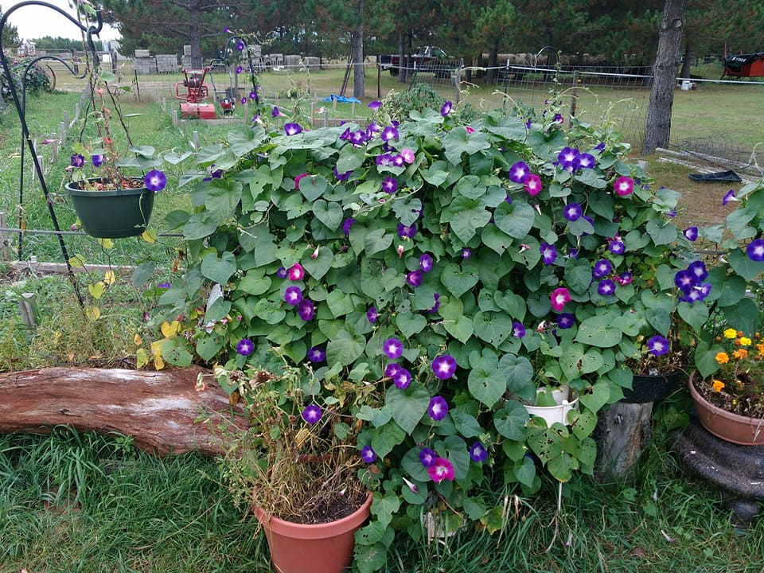
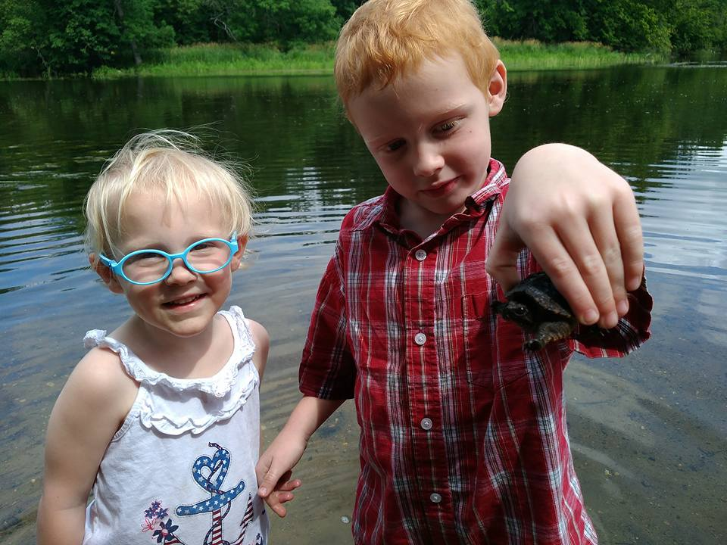
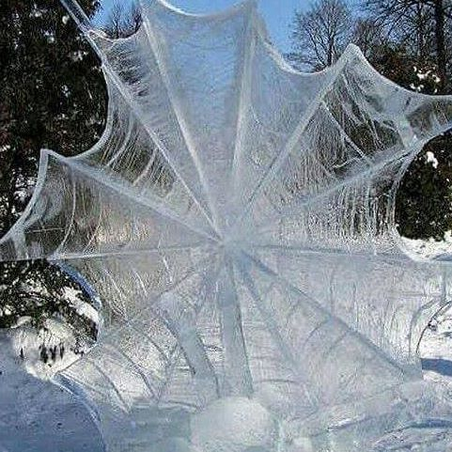
A space to heal

Slide 55
2013 more recovery opportunities
Job loss due to mismanagement
Feelings of worthlessness
Hopelessness
Sinking myself into the calm of nature
Recovering through garden, horses, walks in the pines, family
Creating my own vision through a non-profit advocacy organization

Slide 56

WELLNESS IN THE WOODS

Slide 57
501C3 NON PROFIT WITH A NAME BASED ON NATURE
2016 SAMHSA STATE CONSUMER NETWORK GRANT
WARMLINE
ALL STAFF AND BOARD HAVE LIVED EXPERIENCE
PROVIDING STATEWIDE MENTAL HEALTH EDUCATION
PLANNING FOR MINNESOTA’S FIRST PEER RESPITE
TRANSPARENT
UTILIZES EIGHT DIMENSIONS OF WELLNESS AS A FOUNDATION
PERSON CENTERED AND SUPPORTIVE OF EMPOWERMENT, PERSONAL RESPONSIBILITY AND SELF ADVOCACY

Slide 58

Chief Rangi Ahipene

Slide 59


Slide 60
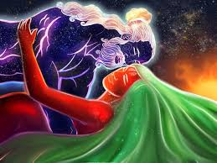

Slide 61


Slide 62
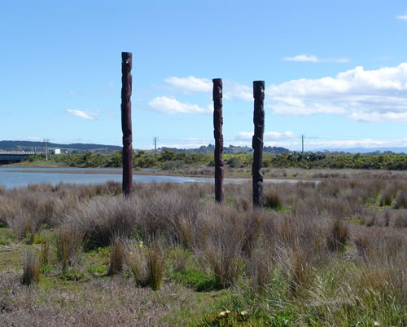

Slide 63


Slide 64
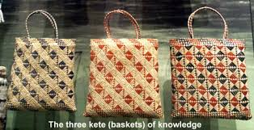

Slide 65
Questions?
You are invited to ask questions at any time through the “question” function. Questions will be taken in the order they are received. You are also welcome to make comments using the “chat” function.

Slide 66
Contact Us
National Coalition for Mental Health Recovery
Web: www.ncmhr.org
Phone: 202-642-4480
International Association of Peer Supporters
Web: http://www.inaops.org
Email: info@inaops.org

Slide 67


